Slide 1



Processamento de Linguagem Natural
Me. Francisco Hércules dos Santos Silva
herculessilva@lapisco.ifce.edu.br

Slide 2
SUMÁRIO
Hugging Face
Transformers
Encoder/Decoder
Sentiment Analysis
Question Answering
Summarization
Translation
Text Generation
Evolução
Referências

Slide 3
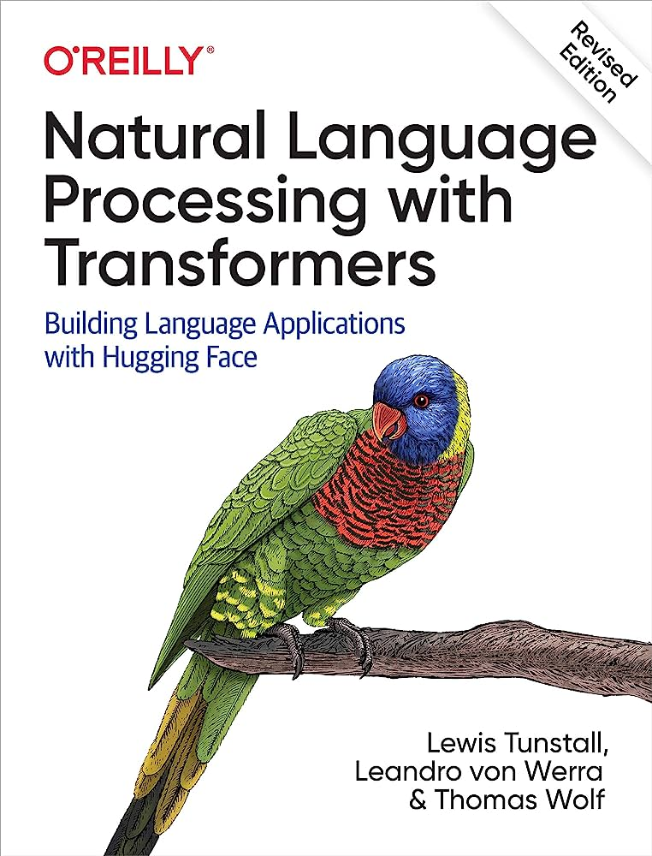
Bibliografia
TUNSTALL, Lewis; VON WERRA, Leandro; WOLF, Thomas. Natural language processing with transformers. " O'Reilly Media, Inc.", 2022.

Slide 4
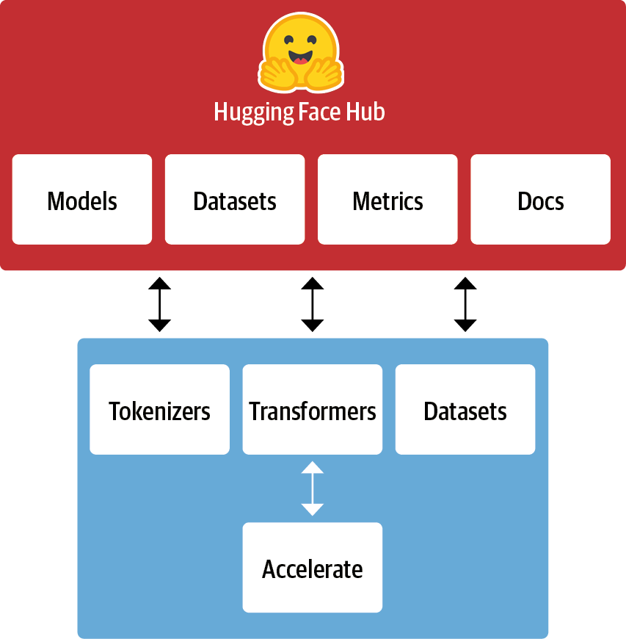
Hugging Face
Fonte

Slide 5
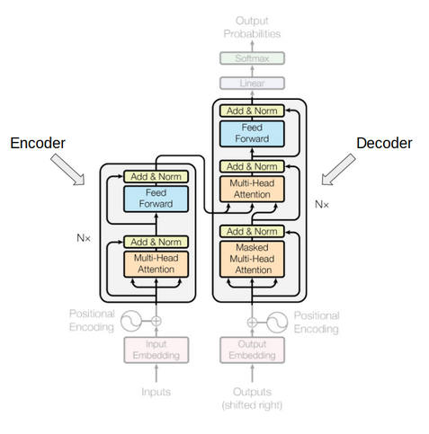
Transformers
Fonte

Slide 6
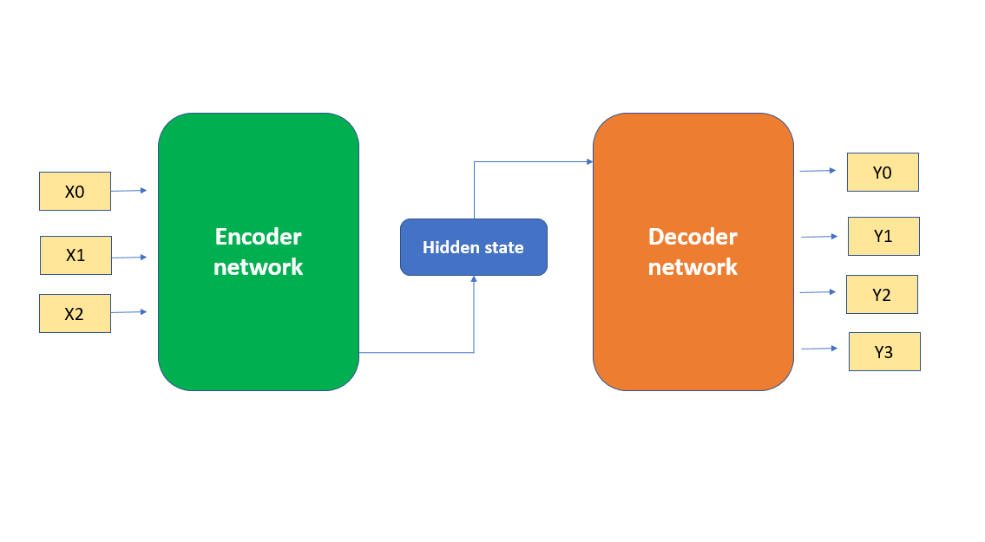
Encoder/Decoder
Fonte

Slide 7
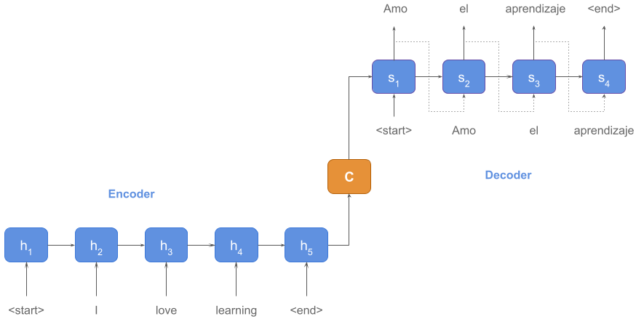
Encoder/Decoder
Fonte

Slide 8
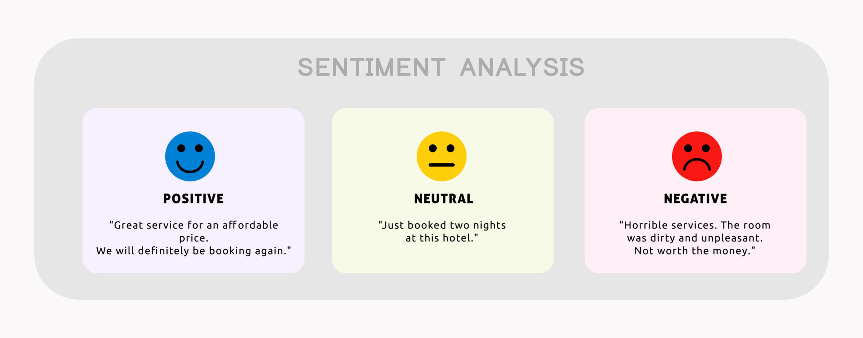
Sentiment Analysis
Fonte

Slide 9

Sentiment Analysis

Slide 10
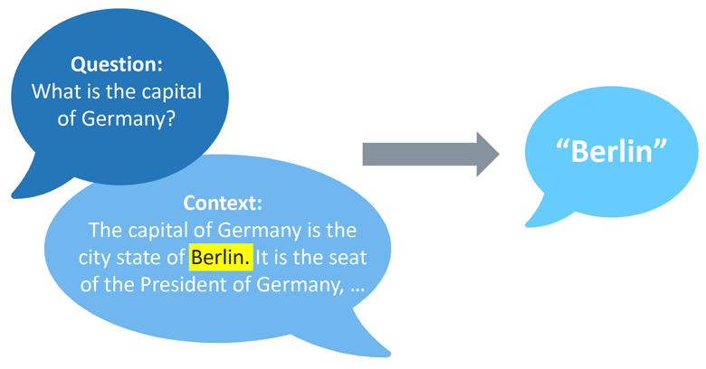
Question Answering
Fonte

Slide 11
Question Answering

Slide 12
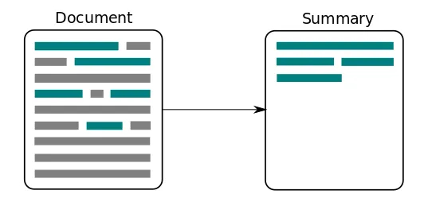
Summarization
Fonte

Slide 13
Summarization

Slide 14
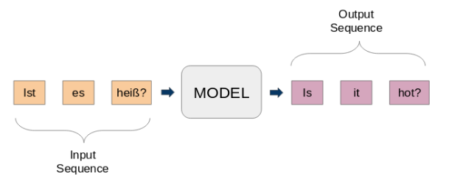
Translation
Fonte

Slide 15
Translation

Slide 16
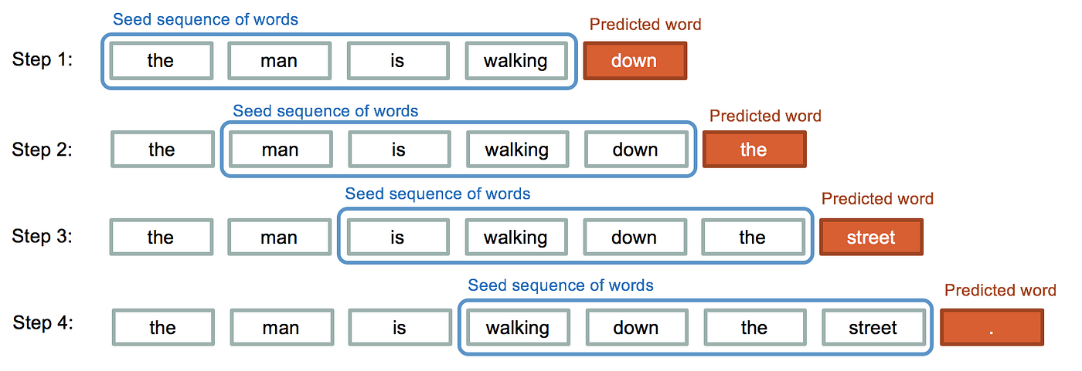
Text Generation
Fonte

Slide 17
Text Generation

Slide 18
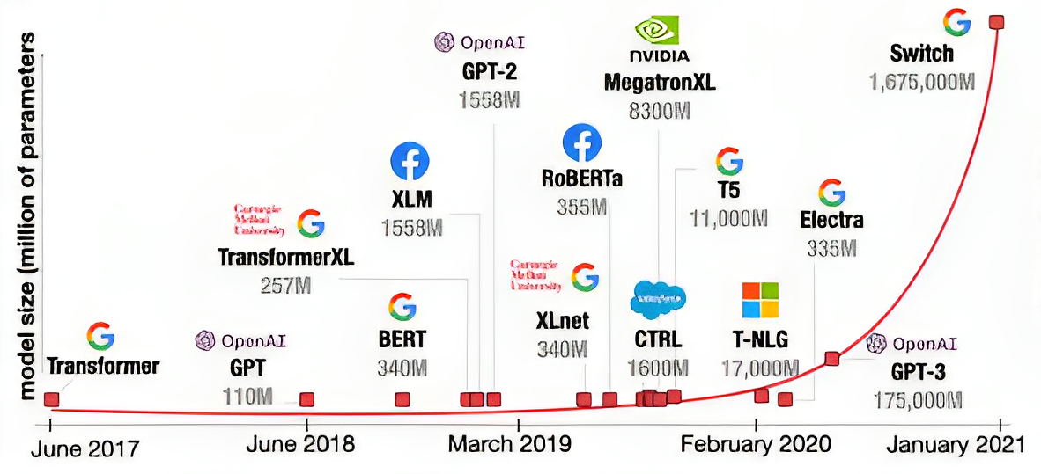
Evolução
Fonte

Slide 19
Links Úteis
https://learn.deeplearning.ai/
https://github.com/nlp-with-transformers/notebooks

Slide 20
Referências
TUNSTALL, Lewis; VON WERRA, Leandro; WOLF, Thomas. Natural language processing with transformers. " O'Reilly Media, Inc.", 2022.

Slide 21
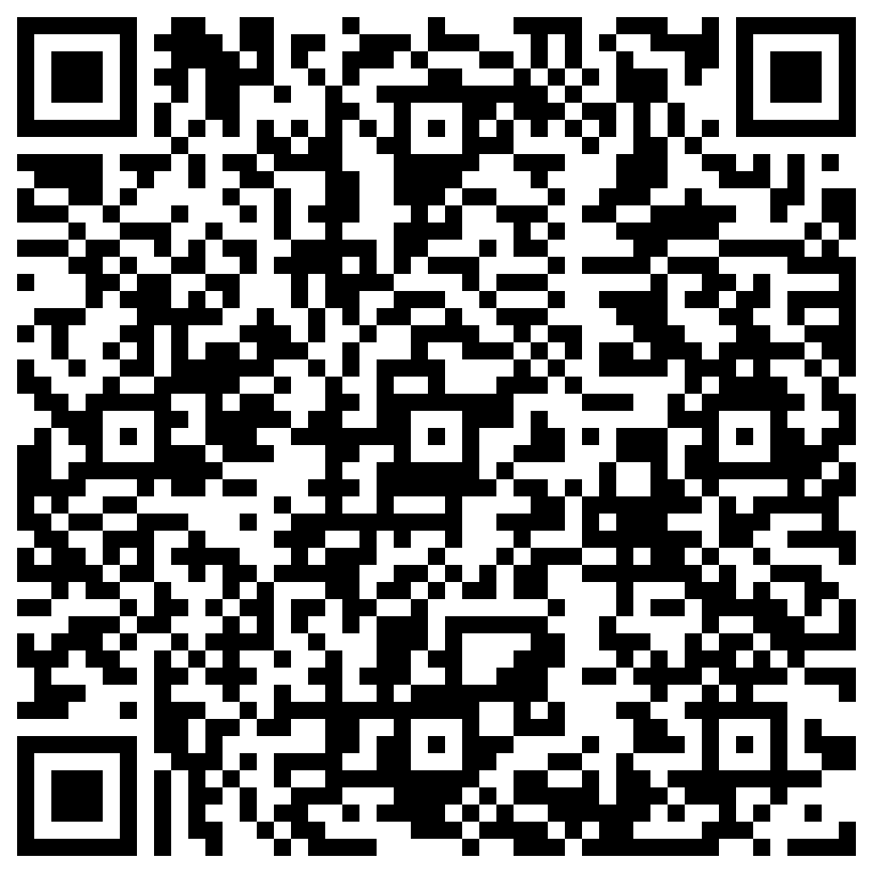
Obrigado pela atenção!
Dúvidas?
Francisco Hércules dos Santos Silva
herculessilva@lapisco.ifce.edu.br

